Slide 1

Features study of MOOC portals

Slide 2
Coursera – Features
Courses in coursera are offered by professors of reputed universities worldwide.
Courses are split to Courses, Specialisation, Certificate, Degree & Master Track. Each with appropriate pricing.

Slide 3

Features - Coursera
Quick summary of the course with information like,
Duration of the course.
Level – Beginner,Intermediate,Advanced.
Skills the user can learn.

Slide 4
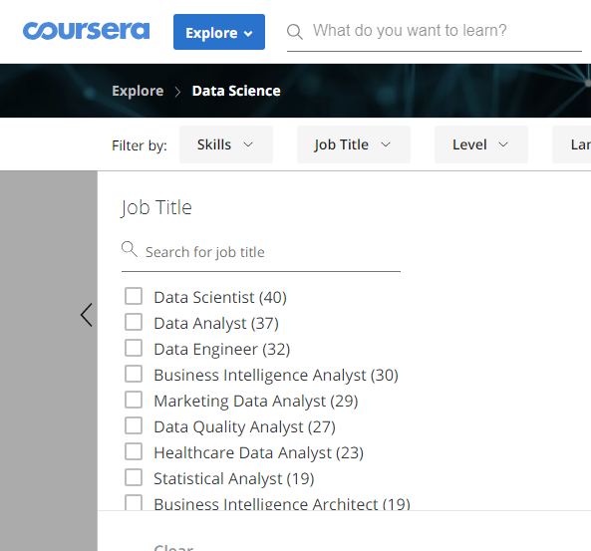
Job Title
Coursera has a filtering option which lets you choose courses based on users job role.

Slide 5

Course fee and trial options
Some of the courses in coursera are free of cost.
When user enrolls in a course tagged specialisation or degree course fee has to be paid.
A free trial period of 7 days is permitted after which course fee has to be paid.
Apply for financial aid – lets student to apply for a financial aid which will be processed within 15 days of submission.

Slide 6
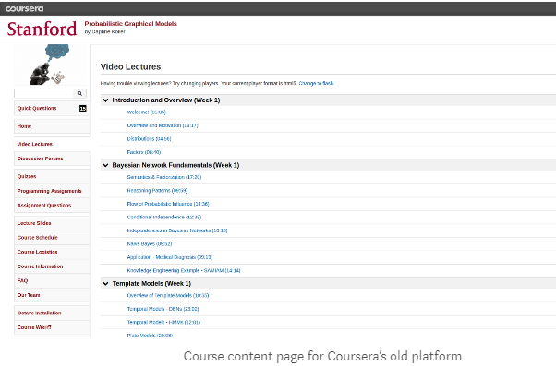
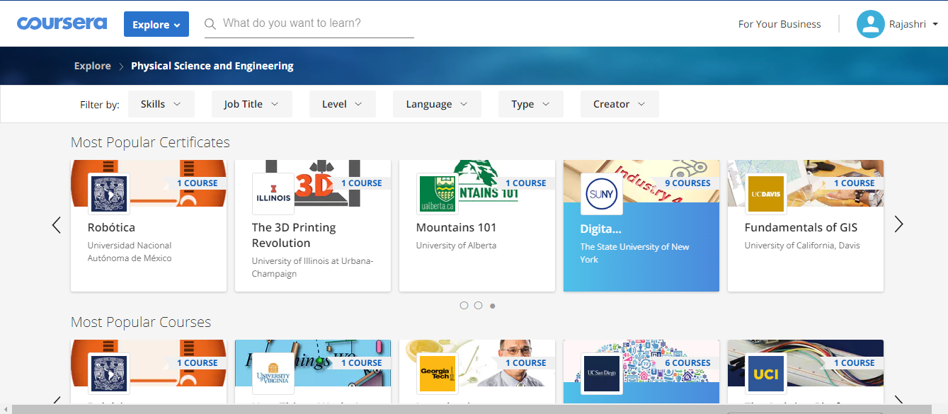
Old vs New Coursera

Slide 7
Personalisation
Personalised LMS for enterprises.
Tools for learner insighhts.
Custom content creation.

Slide 8
Pluralsight
Apart from IT/Development ,Pluralsight also offers courses in music,architecture and design.
So far there are 52 courses in music.

Slide 9
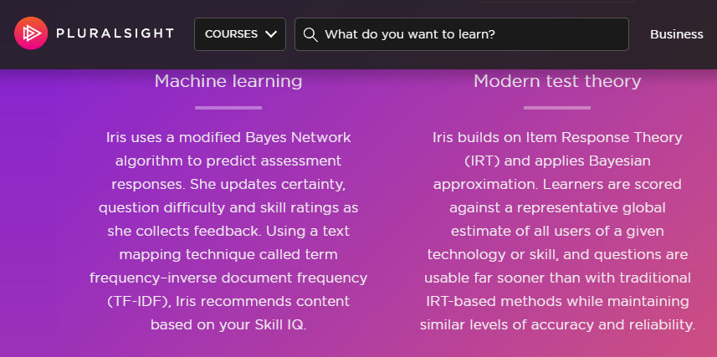
Pluralsight

Slide 10
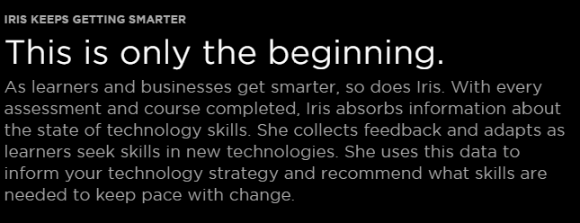
Pluralsight
Pluralsight uses Item Response Theory for evaluating skill level competency.
The machine learning model updates itself by using the data collected over time.

Slide 11

Personalisation
Personalised Learning paths created by experts via face to face or telephonic consultation.
Progress tracker,

Slide 12
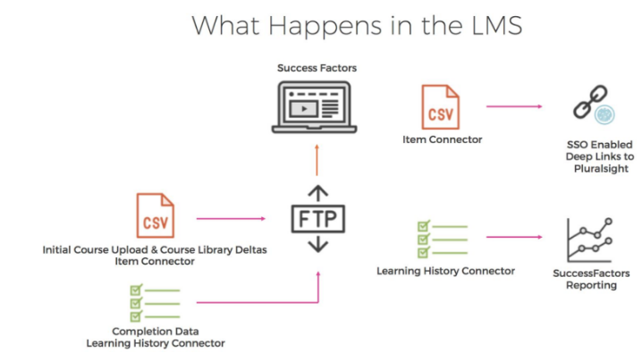
Plural Sight LMS Architecture

Slide 13
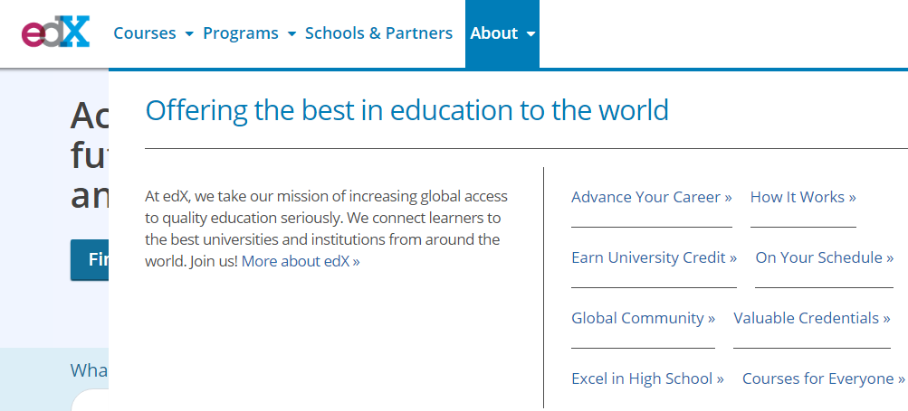
edx
All courses are free to try ,pay whenever a certificate is required.
Subjects are offered by teachers from reputed universities across the globe.

Slide 14
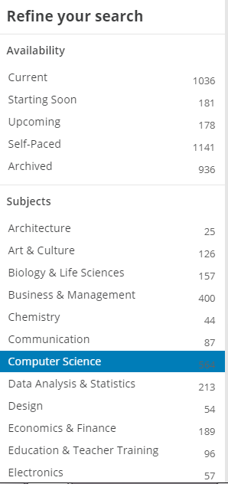
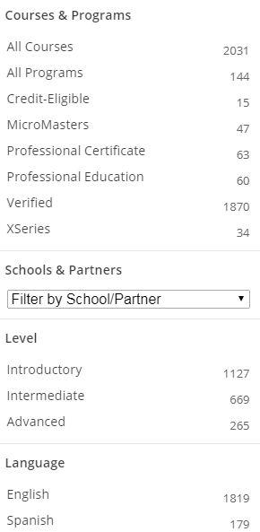

Slide 15
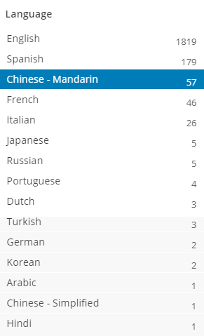
Edx has a visually clear fliter with all the available options listed sideways,unlike a drop down where the user is supposed to search for a course each time.

Slide 16
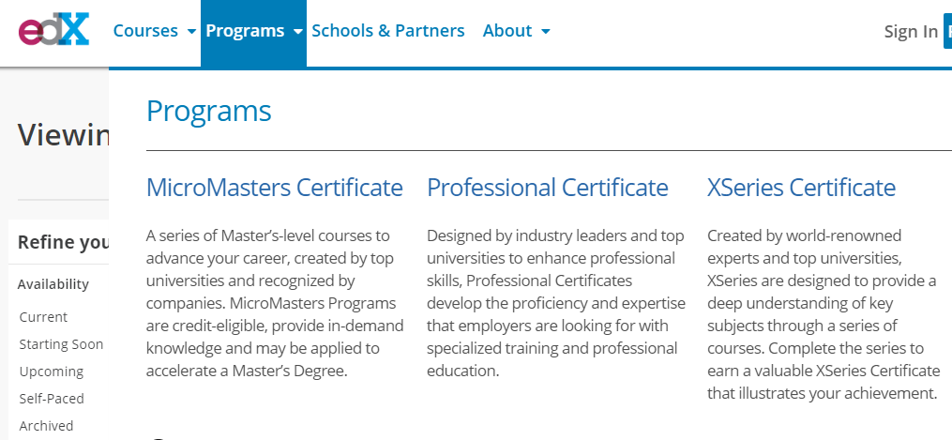
Programs
Micromasters Certificate – Series of master level courses.
Professional Certificate – Certificates which are recognised by companies.
Suitable for professionals who are upskilling.
Xseries Certific - designed to give user an indepth understanding of skills.

Slide 17

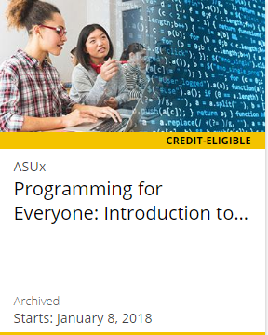
University Credit
Edx allows people to earn a degree from recognised university self paced.

Slide 18

Edx Reviews
Edx has a section in its own site,which is edx learner stories,where users who have enrolled into different courses have given feedback about how the course helped them to achieve more in their profession.
This initiative by edx gives user more confidence about enrolling into their courses.

Slide 19

For High schoolers
For students who are about to join college can take courses offered by edx to bridge gap between high school syllabus to ones which are offered in college.

Slide 20


Edx arts
Apart from traditional education.Edx has 27 courses in music.
69 courses in philosophy and ethics.

Slide 21
Personalisation
User has to pick and read a course,i.e., recommendations are not available unlike pluralsight.
It is integrated with success factor LMS for better learning outcomes.

Slide 22
Udemy
Udemy has anybody can teach,anybody can learn model.
This model has certain drawbacks, unlike other MOOC portals which has course instructors from reputed universities and also the graphics used are all aligned well.
Pricing is also one of the concern,as the courses are owned by the instructors themselves.

Slide 23
Pricing
Since Udemy has instructors who can be anybody, if they know the subject well. They can either sell their material or make it free of cost, its upto them, but Udemy has pricing matrix which they should adhere to if they plan to sell their course.
Price matrix,follow link below,
https://s3.amazonaws.com/udemy-images/support/Udemy+Price+Tier+Matrix+-+EN+09-17+Matrix.pdf

Slide 24
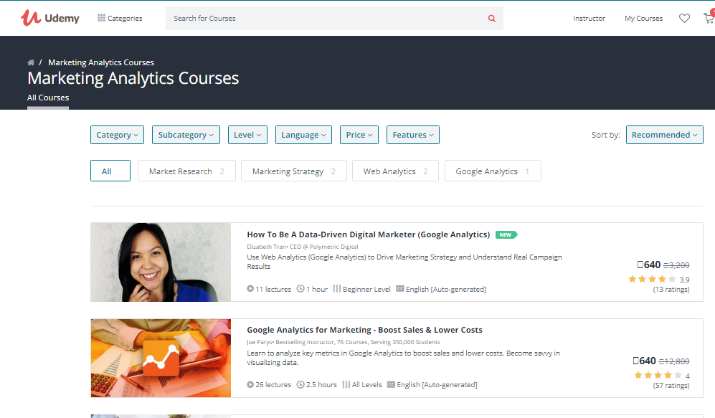

Special Offer
When I was studying about this site,a special offer was available “top courses from Rs.640.
I could see most of the courses priced at Rs.640.
Is it an offer or are we tricked to pay more for a course worth Rs.640.

Slide 25
Udemy Tricks
Udemy gives different pricing for the same product when accessed via different accounts.
https://www.quora.com/Does-Udemy-show-different-prices-of-the-same-courses-on-different-accounts
Another review on Quora for “How good Udemy courses are?”
https://www.quora.com/Are-courses-on-Udemy-good

Slide 26
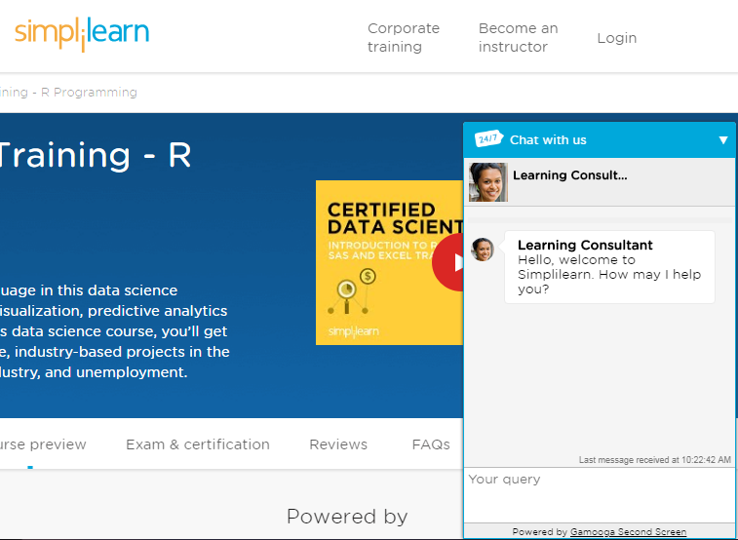
Simplylearn
Simplilearn has courses which could be bucketed under 4 categories.
Whenever you check the site a chat bot which provides custom information to the user.
Must say the chat bot is good unlike Natasha!

Slide 27

Options available

Slide 28

Each course comes with a complementary course.
Six Sigma and Minitab course is available.

Slide 29
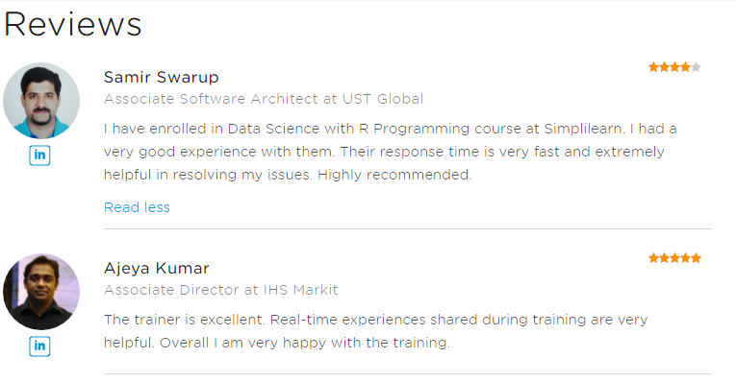
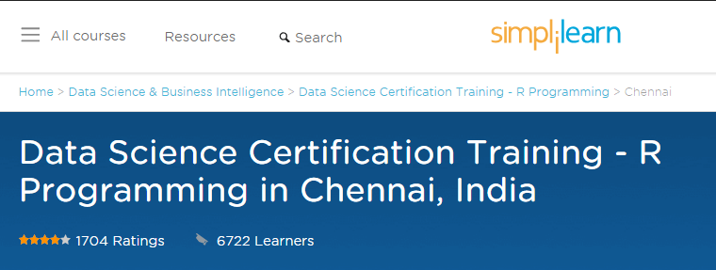
Review
Each course has option to write reviews by people who have enrolled into the course.
Providing number of learners till date also makes the course selection promising.

Slide 30

Infographics

Slide 31
Personalisation
No recommendation, courses are fixed

Slide 32

Upgrad
Upgrad Xchange is for focus groups and one to one exchange of ideas or knowledge.

Slide 33

Upgrad Blog
The landing page has a collection of blog posts closely related to the courses it offers.

Slide 34

Reviews

Slide 35
Recommendations
No recommendations,courses are fixed.

Slide 36
edureka
Edureka provides all a complete package of master degree programs unlike other MOOC sites which offer courses by skills.

Slide 37

Price and skill

Slide 38
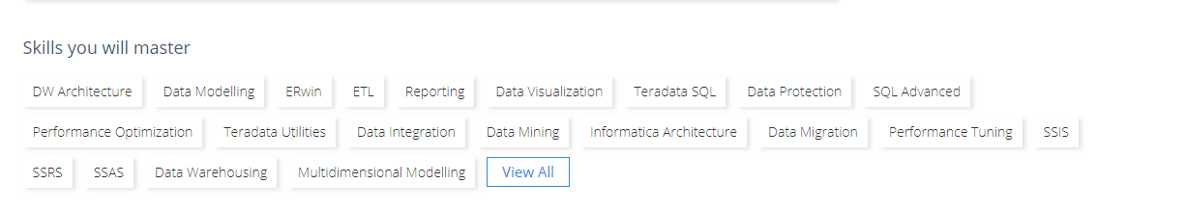
Skills
For the price paid ROI is multiple skills acquired throughout the course.
The course content has life time access.

Slide 39

LMS for Business

Slide 40
Codecademy
For programming and learning scripting.
It comes with 2 versions but pro version is the best.
Since the site offers courses related programming or scripting ,each course has inbuilt simulators for corresponding programming platform.

Slide 41
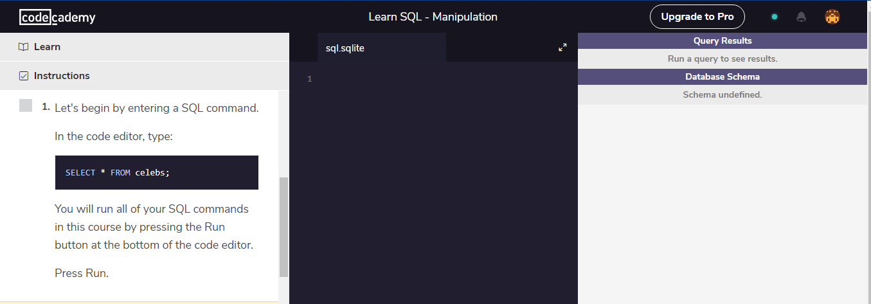
Codecademy - UI

Slide 42
Versions and Pricing
Regular version is free of cost and gives basic hands on exercises for any given programming language.
Pro is a paid version.
Pro intensive is also paid but not same as pro.

Slide 43
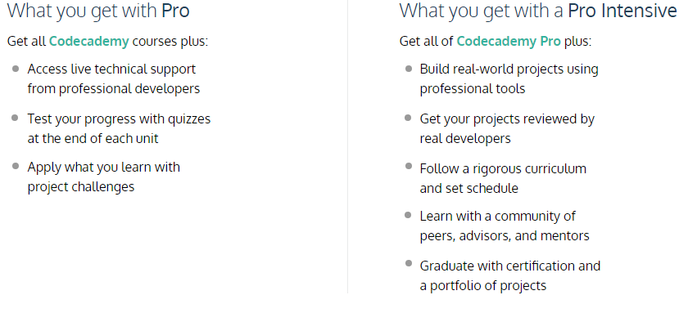

Slide 44
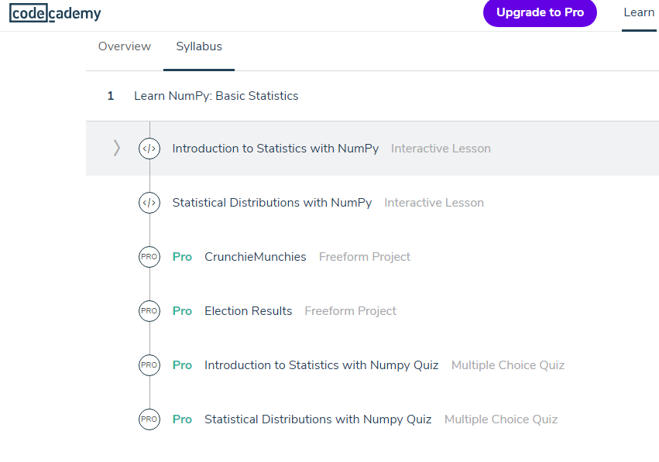
Access levels for pro and regular users.

Slide 45
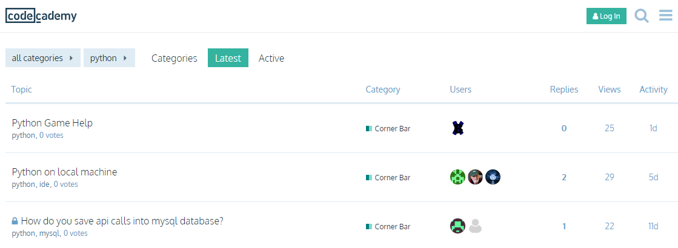
Codecademy forum
This a closed forum for getting help from experts.

Slide 46
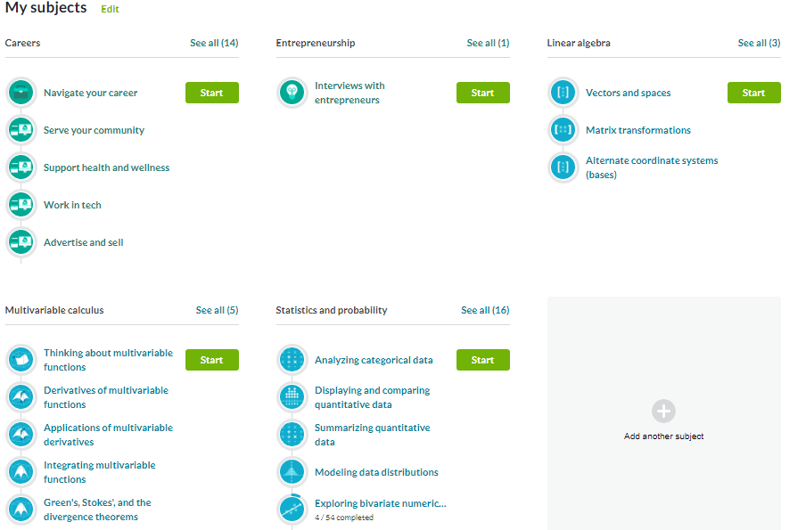
Khan Academy
Non profit organisation, can add learning paths and study self paced.

Slide 47
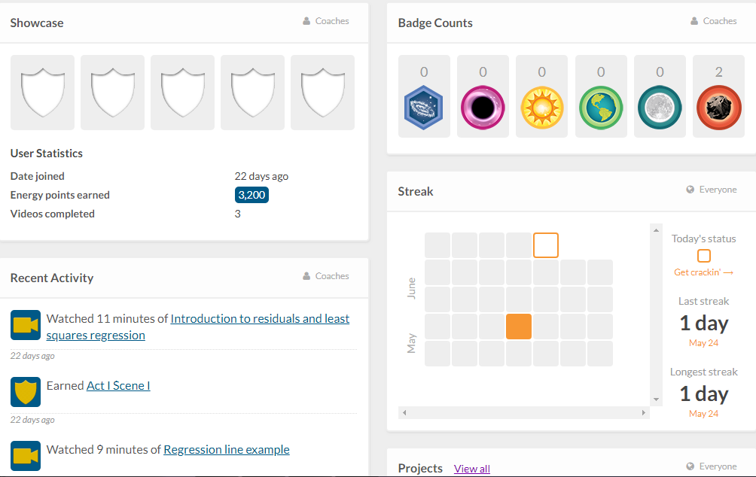
A well focused dashboard and UI/X for kids and high schooler’s.

Slide 48
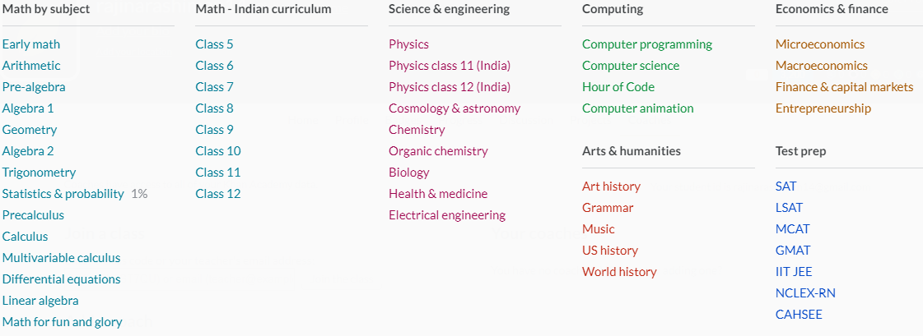
Options

Slide 49
Lynda
All learning paths in lynda are available for linkedin users as linkedin learning.
Apart from students and professionals, it also offers learning solutions for government employees.
Less or no free courses now,but you can try any course for free for a months trial period.

Slide 50
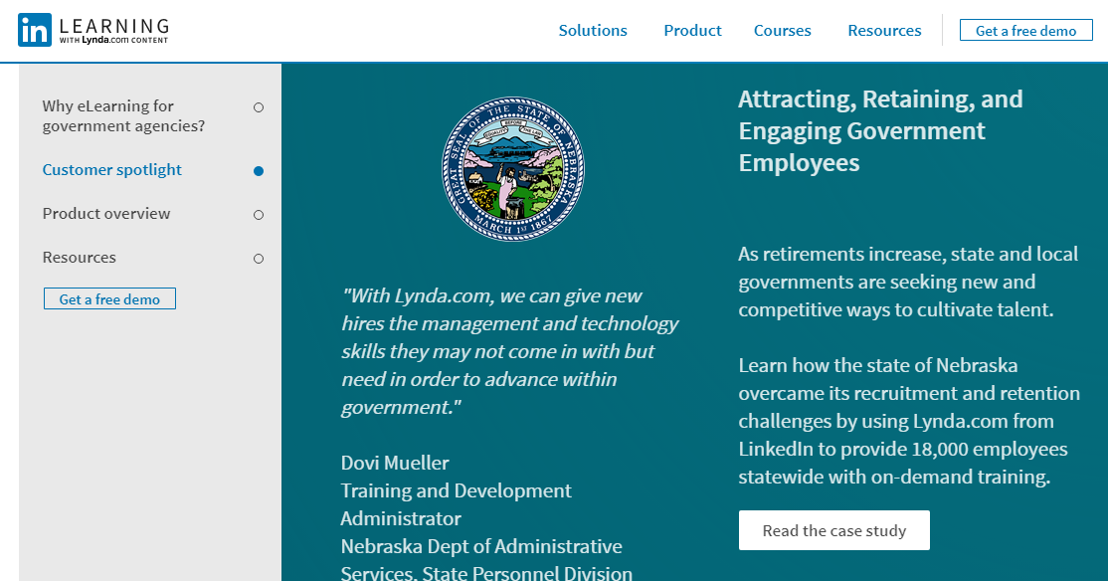

Slide 51
Skillshare
Skillshare has courses classified into 4 categories,
Business,Creative,Technology & Lifestyle.

Slide 52
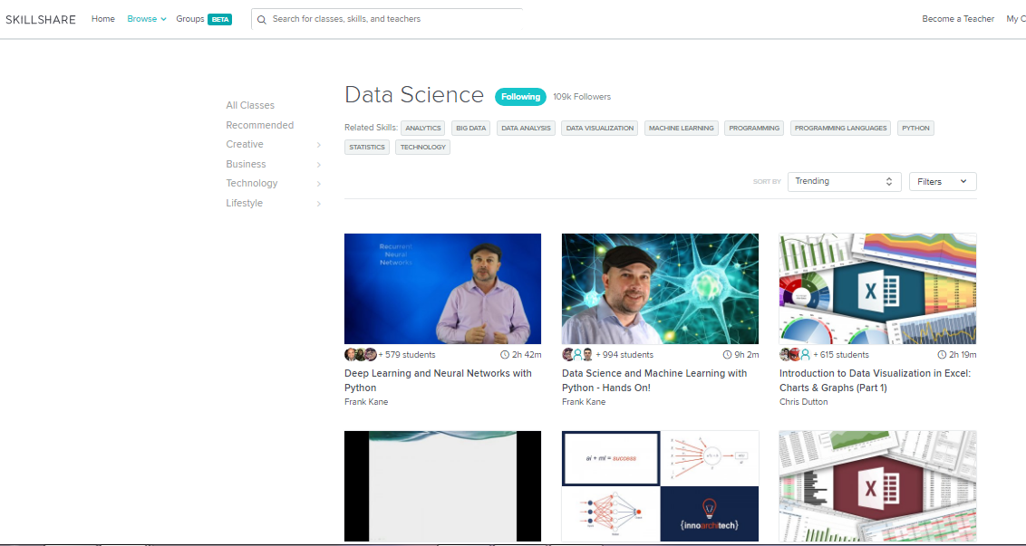
UI of Skillshare

Slide 53

Forums or Focus groups

Slide 54
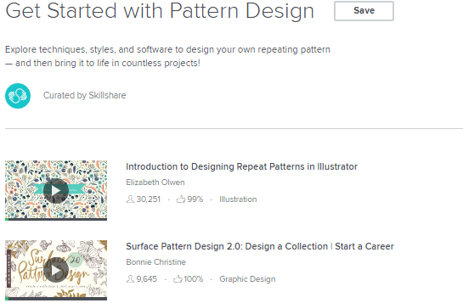
Crafts & Arts
Skillshare offers courses on crafts and other arts.

Slide 55
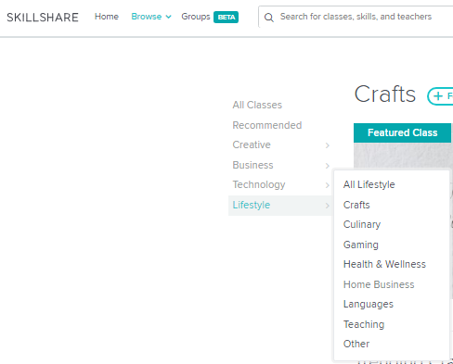


Slide 56
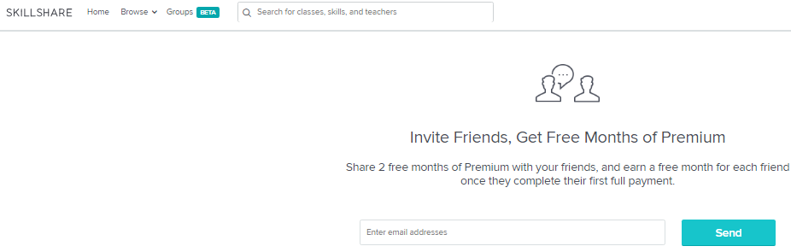
Refer a Friend

Slide 57

Udacity
Course finder view

Slide 58
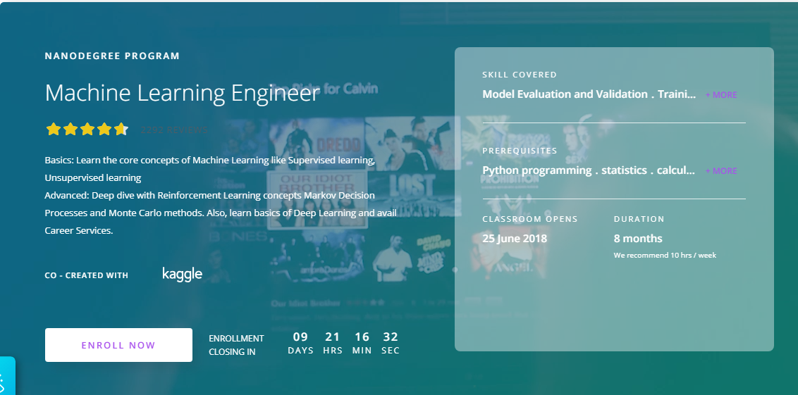
Course Preview

Slide 59
Cross Sell

Slide 60
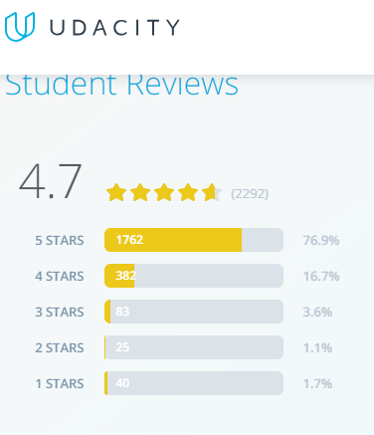

Review

Slide 61
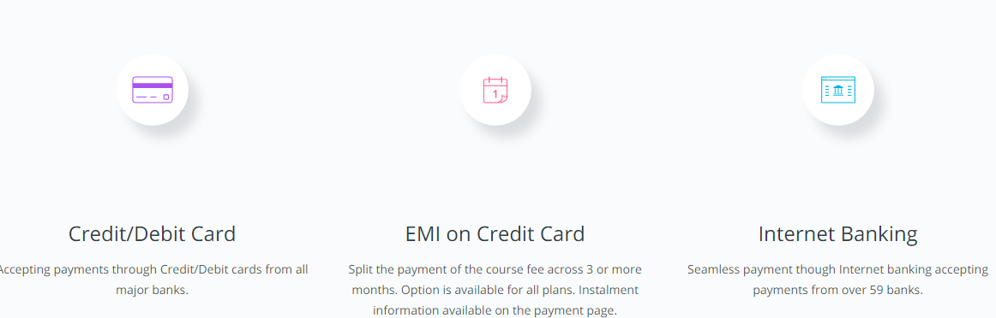
Payment options

Slide 62

Future Learn
Course category preview,

Slide 63
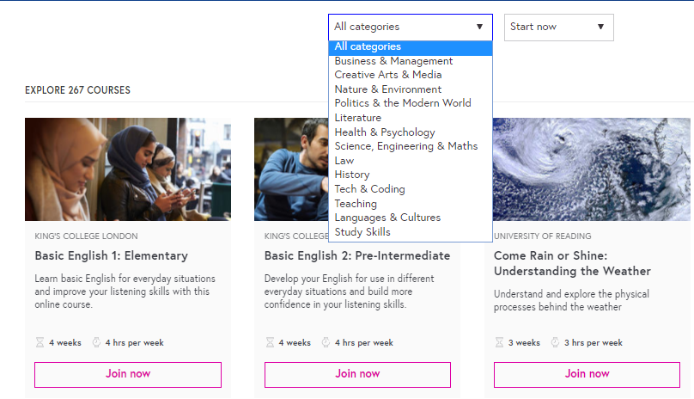
Pick courses from a well structured drop down list,

Slide 64

Color schemes used for programs that are weighed high,like a university degree.

Slide 65
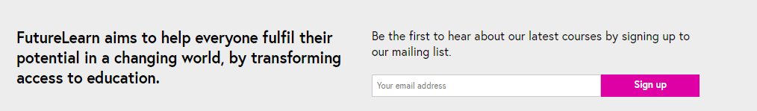
Mailing list for users to know about new courses availability,

Slide 66

Edupristine
Home Page view

Slide 67

Brand Promotion
Free Seminar

Slide 68
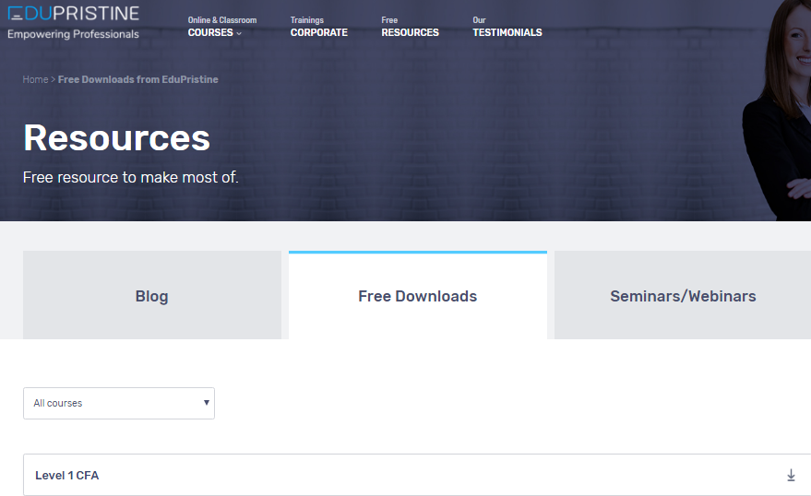
Free downloads
A part of course material is open sourced for each course.

Slide 69
